Slide 1
Calls to Action - Navigators
Debbie Sigurdson, Registrar
Kimberly Ross, Navigator
September 17, 2024

Slide 2
Recommendations from Community Advisory Council (CAC)
3. Create a “Navigator” to assist Indigenous peoples in their access and interaction with WCAT
The CAC recommended that assignment of a “Navigator” to assist Indigenous appellants in providing them with information regarding their access and interaction with WCAT.
Calls_to_Action_Recommendations.pdf (wcat.bc.ca)

Slide 3
WCAT’s Calls to Action Appeal Program

Slide 4
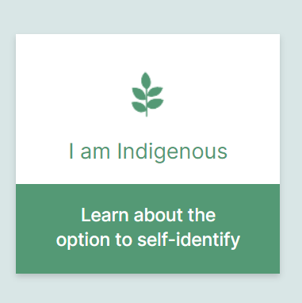
WCAT Navigators
Experienced appeal officers
Indigenous cultural competency training and education
Provide neutral support

Slide 5
Navigators
Provide information through the entire appeal process, ensuring that cultural sensitivities are respected
Navigator information sheet
Early assignment of a navigator
First contact call
Additional calls and letters

Slide 6
Navigators
Help remove barriers so that parties have full and fair access to justice
Disclosure
Canvas information on method of appeal
Inquire about supports and/or liaise to find representation
Special handling memo and early panel assignment
Pre-hearing conferences
Provide additional time

Slide 7
Navigators
Work with Indigenous parties to create a relationship of trust
Phone calls
Attendance at pre-hearing conferences and hearings
Facilitate cultural accommodations
  Alternate hearing location
  Elder attendance at oral hearing
  Smudging
  Other requests

Slide 8
Rep

Slide 9
Successes
Navigator Survey
Increase in self-identification of Indigenous appeal participants
Ongoing and enhanced training
Relationship building
Building open communication

Slide 10
Challenges
Pandemic – more profound impact on Indigenous appeal participants
How and why we are asking “Are you an Indigenous person”
Making contact with the Indigenous appeal participant
Finding support/representation for Indigenous appeal parties
Time: Understanding the time involved in navigating a CTA appeal

Slide 11

Where are we now
Indigenous cultural impact reports
Identifying elders
Identifying and connecting with external resources who can assist WCAT and Indigenous parties
Continued training

