Slide 1
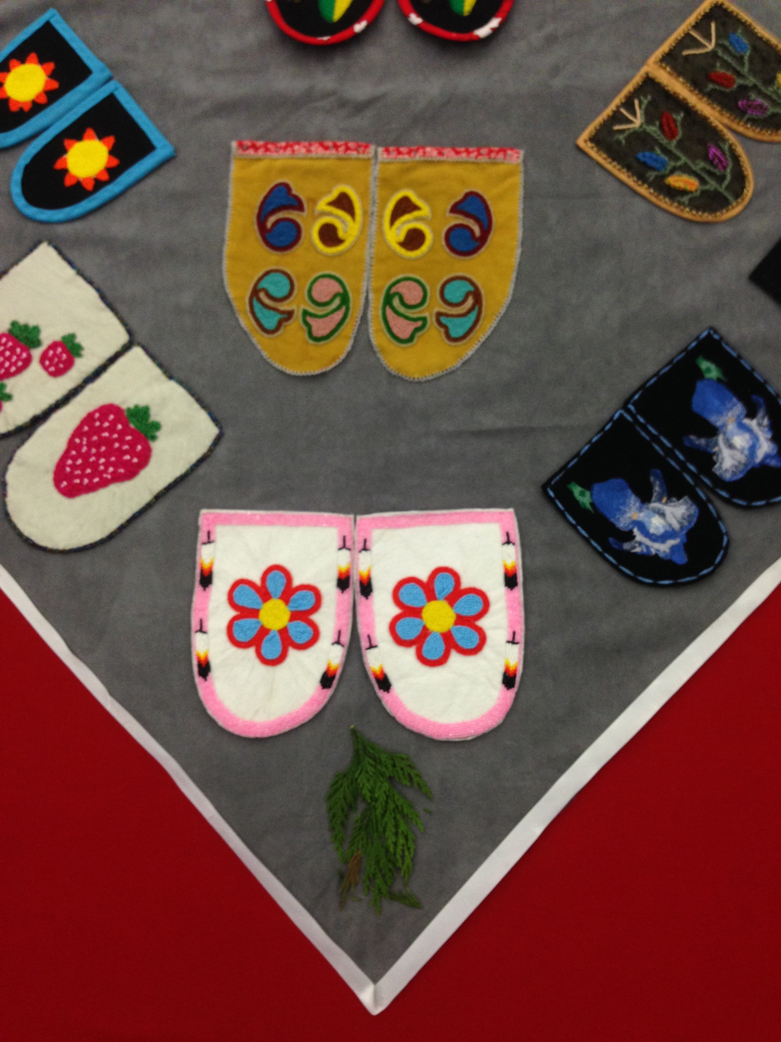
CRT Navigator Role
Photo of vamps taken by Chas Leckie (Shaw) - covering the Missing and Murdered Indigenous Women and Girls installation in K’omoks Hall.
Notes:
Hello all! I would like to take some time to respectfully acknowledge the land that I am coming to you from as an uninvited visitor on the traditional territories of the Songhees, Esquimalt and W̱SÁNEĆ peoples. I am so grateful to be able to live and work on this beautiful land.
Claire Leckie

Slide 2
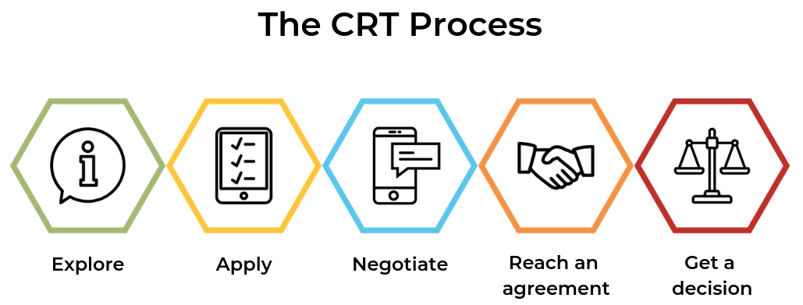
Civil Resolution Tribunal
The Civil Resolution Tribunal is a completely online Civil Claims Tribunal.
We adjudicate claims related to:
Small Claims
Stratas
Co-ops and Societies
Motor Vehicle Incidents
Intimate Image Protection Act Claims
Notes:
The Civil Resolution Tribunal is a completely online Civil Claims Court. We adjudicate claims related to:
Small Claims
Strata
Co-ops and Societies
Motor Vehicle Incidents
Intimate Image Protection Act
Our process begins at intake then Negotiation then facilitaton then finally Tribunal Decision Preparation where the dispute goes to a TM for a final decision
Our mandate is to be timely, flexible, efficient accessible, affordable, and efficient

Slide 3
CRT Reconcili(action) Plan
The CRT is currently updating its Reconcili(action) Plan. It includes short and long-term actions to better serve Indigenous people through the CRT process.
These actions include efforts to hire self-identifying Indigenous people at all levels of the tribunal, decolonizing wording and processes, and finding ways to incorporate Indigenous legal orders into the CRT process to better acknowledge that there is no “one-size-fits-all” approach to resolving disputes.
Part of this Plan also includes the CRT Navigator Role.
Notes:
The plan is available for public viewing on our website.

Slide 4
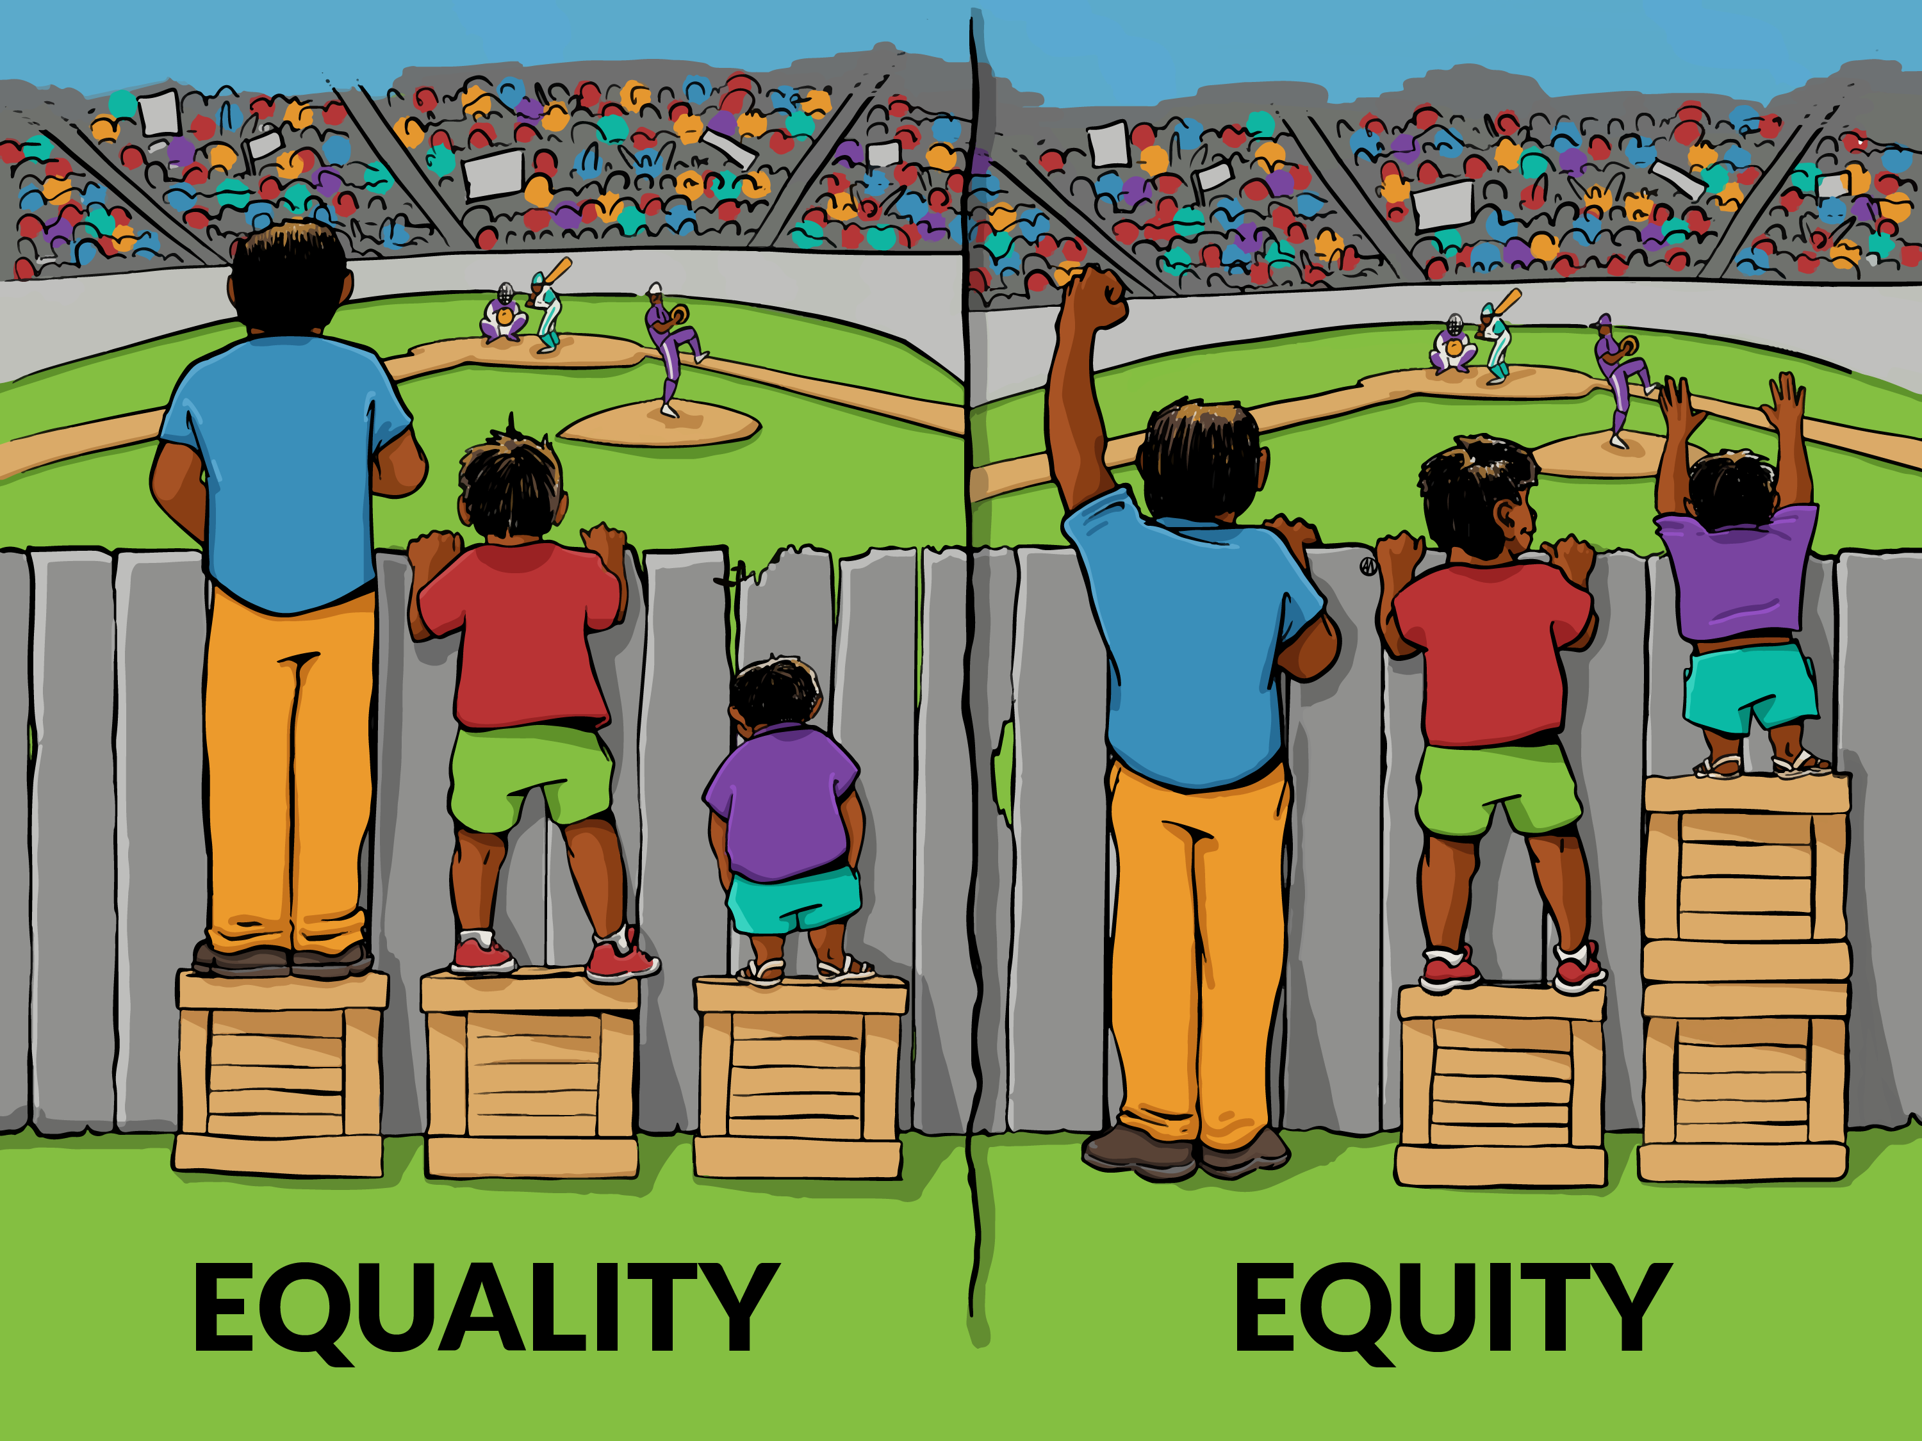
Why the CRT created this role
The CRT created this role to make the CRT process less adversarial than the typical court system.
Indigenous people are being overrepresented in the legal system despite making up only 5% of Canada (statcan.gc.ca).
The CRT recognizes the historical and present experiences of colonialism that Indigenous peoples continue to face in Canada.
Notes:
That can make engaging in a legal process traumatizing, overwhelming, and stressful.

Slide 5
Who the CRT Navigators Are
Kassidy
Joined the Navigator role in June 2023
Intimate Images Protection Act Team Lead
Studied systems of Indigenous governance during my undergraduate degree as well as many courses in Indigenous feminism, and intersectional feminism
Volunteer at the Victoria Sexual Assault Centre where I do work as a crisis support volunteer
Unlearning White Supremacy trainings through VSAC
Francina
Joined the Navigator role in June 2023 as well
Case Manager with Intimate Images Protection Act Team
BA in Justice Studies at Royal Roads University
Mom to an adopted Indigenous child, committed to connecting him to his Indigenous heritage, birth family, and culture
Former foster parent and front-line support worker to families involved with child protection, and the criminal justice system
Notes:
My name is Kassidy I use she/her pronouns. I currently live on the traditional territories of the Songhees, Esquimalt and W̱SÁNEĆ peoples and have lived here for seven years. I was born and raised on the traditional territories of the Tsuut’ina, Blackfoot, Stoney, Ktunaxa, and Michif Piyii Metis nations in Alberta. I love the west coast and am so grateful to live here. I am a white settler of European ancestry. I currently work as an Intimate Images Protection Act Team Lead. I joined the Navigator role in June 2023 because I am passionate about justice accessibility. I studied systems of Indigenous governance during my undergraduate degree as well as many courses in Indigenous feminism, and intersectional feminism. I volunteer at the Victoria Sexual Assault Centre where I do work as a crisis support volunteer. I participate in an Unlearning White Supremacy training through VSAC. My learning is ongoing and I strive to bring the skills I learn in my role at VSAC, on the IIPA team, and CRT knowledge to the role of Navigator.

Slide 6
Training Since 2017, all CRT staff and full-time tribunal members have been required to complete the following courses to better understand and acknowledge the unique experiences and worldviews of Indigenous peoples: - Cultural Perspectives Training - Trauma-Informed Practice Training - Cultural Humility Training - Implicit Bias Training - Indigenous and Canadian Histories 101 Additionally, Navigators complete the Indigenous Canada course through UofA.
Course/training | Website | Notes
Indigenous Canada through UofA | https://www.ualberta.ca/admissions-programs/online-courses/indigenous-canada/index.html | 12 week, correspondence course
Indigenous and Canadian Histories 101: What you didn’t learn in high school | http://rainwatch.ca/training | 45minutes
Allyship: Authentic vs Performative | https://adric.ca/diversity-stream/ | On demand recording of the presentation 121 minutes
Cultural Perspectives Training | https://ipsociety.ca/training/cultural-perspectives-training/cultural-perspectives-training/ | Full day course CRT attended in a large group
Notes:
Since 2017, all CRT staff and full-time tribunal members have been required to complete cultural competency, Trauma-informed Practice, and cultural humility training in order to better understand and acknowledge the unique experiences and worldview of Indigenous peoples.
Navigators take the Indigenous Canada course through UofA.
Add a personal slide for me and Francina’s connection to the work.

Slide 7
What am I able to provide the party?
Provide Information and answer questions about each stage of the CRT process
Support during the CRT process
Information regarding legal resources or other places where they can get help with their legal problems/inquiries
Help with navigating the CRT forms and assistance with uploading evidence and arguments into the CRT online platform
Notes:
When parties self-identify as Indigenous, we send them a welcome email that covers the services that we are able to offer as well as our direct phone numbers if they need to call us. Navigator services are optional. Typically we arrange a phone call to discuss the CRT process and clarify any concerns parties have or we communicate over email. We then work with them as needed through the entire CRT process.
Most often I’ve assisted with clarifying emails, helping to navigate application or response forms, provide a deeper explanation of the CRT process, and providing emotional support along the way.
Allows us to take our time with parties and listen to their stories along with helping through the process.

Slide 8
What I am not able to provide
If they should submit a claim (usually)
How much to ask for, naming or locating the parties
What evidence to submit
If I think they will be successful
Clarification regarding their Decision
Notes:
I cannot provide legal advice or help with another legal process.
I cannot directly transfer parties to additional resources.

Slide 9
Resources for Referral
Name of Organization | Name of Organization
Native Court Worker and Counselling Association of British Columbia | Aboriginal Legal Aid in BC
Community Legal Assistance Society | Justice Access Centre
BC Association of Aboriginal Friendship Centres | AccessProBono
Aboriginal Services and Resources BC | Bella Coola Legal Advocacy Program
Legal Aid BC | BC Human Rights Tribunal
Notes:
Here is a list of resources I can provide if the CRT is unable to help the party with their question. Depending on their needs and location, we have a list with over 100 resources we can provide to them as well.
We often refer parties to these organizations for affordable or free legal advice. Most commonly CLAS, Legal Aid BC, Access ProBono, and NCWCCA of BC.
Unfortunately, there aren’t many administrative legal clinics specific to Indigenous peoples. This is one of the challenges we face.

Slide 10
Information We Collect
Date of Self-Identification
Name
Party type
Dispute number
Party in dispute (applicant or respondent)
Location (urban, rural, unknown)
Did the party respond to the Navigator template
Response if they did reply
Did the party use a fee waiver
Identify if they need special accommodations/disability we should be aware of
Need to use interpretations services
Helper or representative requests. Was the request approved or denied.
What stage of dispute resolution did the party request help (if at all)
Outcome of the dispute
Were they sent the CRT satisfaction survey
Are they challenging the decision (Notice of Objection or Judicial Review)
Notes:
These are all the statistics that we collect when a party self-identifies as Indigenous.

Slide 11
What the information is used for
To help the CRT better understand the needs of Indigenous participants
Aid in implementing the CRT’s Reconcili(action) Plan
Ensure that the CRT services are reaching Indigenous folks everywhere in BC
If usage is low, the CRT can work on community relationships, and building trust and respect with Indigenous communities
Notes:
Through our data tracking, we have been able to see that the CRT may not be known to/accessible for Indigenous folks in rural and remote areas.
We are currently working on reaching out to a list of friendship centres and Indigenous legal resources across the province to increase awareness.
We are updating our website based on feedback we’ve received.

Slide 12
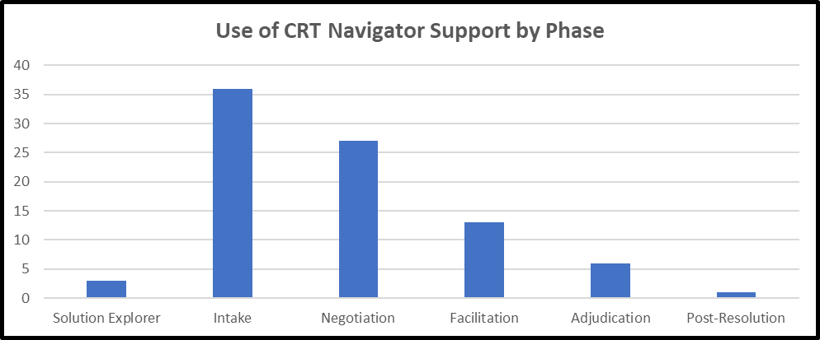
Successes
291 parties self-identified as Indigenous since 2020-2024
Number has grown every year from 4 parties in 2020-2021 to 158 parties in 2023-2024
Approximately 50% of parties that self-identified as Indigenous used navigator support at some point during the CRT process
Representative requests for Indigenous parties have been approve 100% of the time
Use of CRT Navigator Support by Phase 2023-2024.
Notes:
Leading a project to create an participant satisfaction survey for Indigenous parties to get qualitative feedback as well.

Slide 13
Challenges
Our current Navigators are both white settlers
Finding resources for legal advice for Indigenous folks in civil law is difficult
Not all Indigenous parties are comfortable self-identifying to the CRT
It is difficult reaching Indigenous parties in rural and remote areas
Accessibility is challenging for folks who don’t have regular access to a phone or computer
Notes:
Our current Navigators are both white settlers
This can make Indigenous folks accessing our services uncomfortable
It is important for cultural safety to speak with other Indigenous folks
Finding resources for legal advice for Indigenous folks in civil law is difficult
We refer many parties to other resources for legal advice, there are long waitlists and it is challenging to find legal professionals to help with the CRT process
Not all Indigenous parties are comfortable self-identifying to the CRT
The legal system historically has been used to criminalize and colonize Indigenous folks, many people are not comfortable self-identifying for those reasons and we don’t offer the Navigator role to anyone
It is difficult reaching Indigenous parties in rural and remote areas
Our data has shown this
Accessibility is challenging for folks who don’t have regular access to a phone or computer
We do the CRT process via mail in this case which can be difficult for clarifying questions, people can go into Service BC locations for assistance but employees are not always versed in the CRT process
We worked with a Community Advisory Committee comprised of Indigenous legal professionals and academics to get their advice on how to address these challenges.
Artwork is by Clayton Gauthier and is on our website as well.

Slide 14
Our Next Steps
The CRT is looking into creating job profiles that require Indigenous heritage for the Navigator position
We are reviewing our hiring processes generally to hire more Indigenous staff members
We are going to begin outreach to friendship centres, Indigenous legal organizations, and other Indigenous based organizations to increase awareness of the CRT
We are updating our website for clarity and plain language
Updating our Reconciliation plan for 2025
Notes:
With recommendations from the Community Advisory Committee, we are revising and updating our reconciliation plan at the CRT.
To improve cultural safety for Indigenous folks accessing Navigator services, we are looking to hire Indigenous Case Managers to take over the role, as well as revising our hiring process generally to increase Indigenous folks within our staff and all stages of the CRT process
The CRT is actively hiring Indigenous Case Managers to take over the Navigator role as we recognize the importance of cultural safety
We are reviewing our hiring processes generally to hire more Indigenous staff members
On the advice of the CAC, we are going to reach out directly to a number of friendship centres, Indigenous legal organizations, and other Indigenous based organizations with posters and job postings to increase awareness of the CRT, as well as updating our website for clarity and plain language.
There is a disproportionate number of Indigenous folks from urban centres versus rural areas
We will be addressing these challenges in the new reconciliation plan that we will be working on

Slide 15
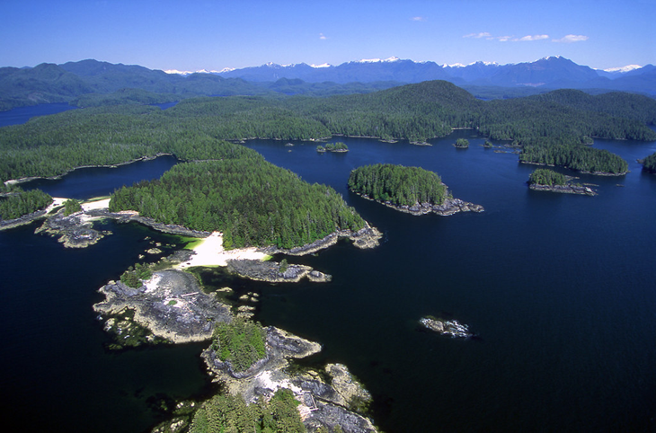
Thank you!

